Slide 1


INSTANT
INSTANT
INSTANT
Block the effect of another Instant card and discard it
Block the effect of another Instant card and discard it
Block the effect of another Instant card and discard it
INSTANT
INSTANT
INSTANT
NOPE!
NOPE!
Prevent another player from declaring the workbench finished
Prevent another player from declaring the workbench finished
Block the effect of another Instant card and discard it
INSTANT
INSTANT
INSTANT
NOPE!
NOPE!
Prevent another player from declaring the workbench finished
Prevent another player from declaring the workbench finished
Destroy a card of your choice from the workbench

Slide 2
INSTANT
INSTANT
INSTANT
INSTANT
INSTANT
INSTANT
INSTANT
INSTANT
INSTANT

Slide 3


INSTANT
INSTANT
INSTANT
Destroy a card of your choice from the workbench
Destroy a card of your choice from the workbench
Destroy a card of your choice from the workbench
INSTANT
INSTANT
INSTANT
Reverse the turn order after the current player’s turn ends.
Reverse the turn order after the current player’s turn ends.
Prevent a player from playing cards onto the workbench this turn
INSTANT
INSTANT
INSTANT
Prevent a player from playing cards onto the workbench this turn
Play 1 card onto the workbench
Play 1 card onto the workbench

Slide 4
INSTANT
INSTANT
INSTANT
INSTANT
INSTANT
INSTANT
INSTANT
INSTANT
INSTANT

Slide 5
INSTANT
INSTANT
INSTANT
INSTANT
INSTANT
INSTANT
Play 1 card onto the workbench
Steal 1 card from another player’s hand
Steal 1 card from another player’s hand
INSTANT
INSTANT
INSTANT
INSTANT
INSTANT
INSTANT
Discard 2 cards from another player’s hand
Discard 2 cards from another player’s hand
Force a player to discard and redraw their hand, up to the same number of cards.
INSTANT
INSTANT
INSTANT
INSTANT
INSTANT
INSTANT
INSTANT
INSTANT
Force a player to discard and redraw their hand, up to the same number of cards.
Swap hands with another player
Swap hands with another player

Slide 6
INSTANT
INSTANT
INSTANT
INSTANT
INSTANT
INSTANT
INSTANT
INSTANT
INSTANT

Slide 7



INSTANT
INSTANT
INSTANT
INSTANT
INSTANT
INSTANT
Swap the position of any 2 cards on the workbench
Swap the position of any 2 cards on the workbench
Swap the position of any 2 cards on the workbench
INSTANT
INSTANT
INSTANT
INSTANT
INSTANT
INSTANT
Swap the position of any 2 cards on the workbench
Swap the position of any 2 cards on the workbench
Shuffle the discard pile into the deck
INSTANT
INSTANT
INSTANT
INSTANT
INSTANT
INSTANT
INSTANT
INSTANT
Shuffle the discard pile into the deck
Look at a single card of your choice on the workbench
Look at a single card of your choice on the workbench

Slide 8
INSTANT
INSTANT
INSTANT
INSTANT
INSTANT
INSTANT
INSTANT
INSTANT
INSTANT

Slide 9

INSTANT
INSTANT
INSTANT
INSTANT
INSTANT
INSTANT
INSTANT
INSTANT
INSTANT
Look at a single card of your choice on the workbench
Look at a single card of your choice on the workbench
Look at a single card of your choice on the workbench
INSTANT
SABOTAGE
SABOTAGE
INSTANT
INSTANT
INSTANT
INSTANT
Look at a single card of your choice on the workbench
Destroy the card directly above this card
Destroy the card directly above this card
INSTANT
INSTANT
INSTANT
INSTANT
INSTANT
INSTANT
INSTANT
INSTANT
INSTANT
INSTANT
INSTANT
Swap a Sabotage or Material card in your hand with a card on the workbench
Swap a Sabotage or Material card in your hand with a card on the workbench
Swap a Sabotage or Material card in your hand with a card on the workbench

Slide 10
INSTANT
INSTANT
INSTANT
SABOTAGE
SABOTAGE
INSTANT
INSTANT
INSTANT
INSTANT

Slide 11

SABOTAGE
SABOTAGE
SABOTAGE
INSTANT
INSTANT
INSTANT
Destroy the card directly above this card
Destroy the card directly above this card
Destroy the card directly above this card
SABOTAGE
SABOTAGE
SABOTAGE
INSTANT
INSTANT
INSTANT
INSTANT
INSTANT
Destroy the card directly below this card
Destroy the card directly below this card
Destroy the card directly below this card
SABOTAGE
SABOTAGE
SABOTAGE
INSTANT
INSTANT
INSTANT
INSTANT
INSTANT
Destroy the card directly below this card
Destroy the card directly below this card
Destroy 1 card on the workbench randomly (after the stack has been resolved)

Slide 12
SABOTAGE
SABOTAGE
SABOTAGE
SABOTAGE
SABOTAGE
SABOTAGE
INSTANT
INSTANT
INSTANT
SABOTAGE
SABOTAGE
SABOTAGE
INSTANT
INSTANT
INSTANT

Slide 13

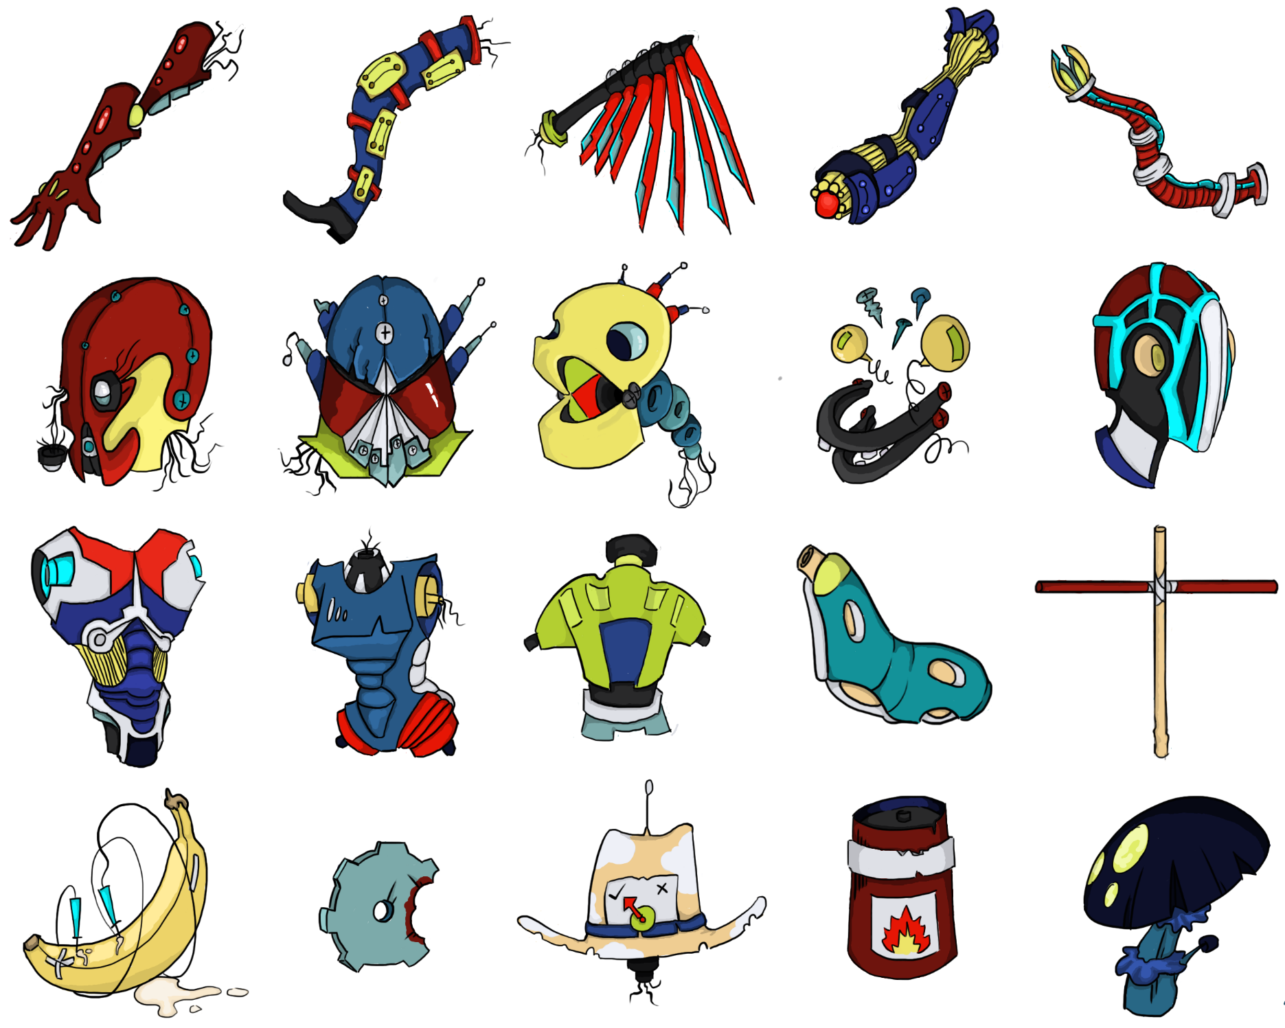

SABOTAGE
SABOTAGE
SABOTAGE
INSTANT
Choose 1 sabotage card still on the workbench (including this one) & destroy it
Choose 1 sabotage card still on the workbench (including this one) & destroy it
Destroy 1 card on the workbench randomly (after the stack has been resolved)
SABOTAGE
MATERIAL
MATERIAL
No Effect
HEAD
HEAD
MATERIAL
MATERIAL
MATERIAL
HEAD
HEAD
HEAD

Slide 14
SABOTAGE
SABOTAGE
SABOTAGE
MATERIAL
MATERIAL
SABOTAGE
MATERIAL
MATERIAL
MATERIAL

Slide 15



MATERIAL
MATERIAL
MATERIAL
TORSO
TORSO
TORSO
MATERIAL
MATERIAL
MATERIAL
TORSO
TORSO
LIMB
MATERIAL
MATERIAL
MATERIAL
LIMB
LIMB
LIMB

Slide 16
MATERIAL
MATERIAL
MATERIAL
MATERIAL
MATERIAL
MATERIAL
MATERIAL
MATERIAL
MATERIAL

Slide 17
MATERIAL
MATERIAL
MATERIAL
LIMB
LIMB
LIMB
MATERIAL
MATERIAL
MATERIAL
LIMB
LIMB
LIMB
MATERIAL
MATERIAL
MATERIAL
LIMB
LIMB
LIMB

Slide 18
MATERIAL
MATERIAL
MATERIAL
MATERIAL
MATERIAL
MATERIAL
MATERIAL
MATERIAL
MATERIAL

Slide 19
MATERIAL
MATERIAL
MATERIAL
LIMB
LIMB
LIMB
MATERIAL
MATERIAL
MATERIAL
LIMB
LIMB
LIMB
MATERIAL
MATERIAL
MATERIAL
LIMB
JUNK
JUNK

Slide 20
MATERIAL
MATERIAL
MATERIAL
MATERIAL
MATERIAL
MATERIAL
MATERIAL
MATERIAL
MATERIAL

Slide 21
MATERIAL
MATERIAL
MATERIAL
JUNK
JUNK
JUNK

Slide 22
MATERIAL
MATERIAL
MATERIAL

